Slide 1
ULTRA-BULLET
CHESS CLOCK
LOGDSGN
Project Presentation
John Carlo Cheng Roa
Nirah Delfin
Julio Luis Gabriel Ticzon

Slide 2
BRIEF DESCRIPTION
An Ultra-Bullet Digital Chess Clock is a two-player sequential countdown timer designed with sequential and combinational logic. The circuit features a 1 Hz clock generator, a 74LS74-based player turn state register, 74LS08 gating logic, 74LS192 synchronous BCD countdown counters (9 to 0), 74LS47 decoder/drivers with 7-segment displays, and terminal count alarm buzzers.

Slide 3
COMPONENTS USED
  LM555CN / NE555: Astable multivibrator clock generator (1 Hz target)
  74LS74N: Dual D-Type Flip-Flop (Player-state toggle register)
  74LS08D: Quad 2-Input AND gates (Clock gating & routing)
  74LS192N: Synchronous Up/Down BCD Counters
  74LS47N: BCD-to-7-Segment Decoder / Drivers
  Outputs & Passives: Common-anode 7-segment displays, active buzzers (200 Hz/5 V), 270Ω segment current-limiting resistors, 10 kΩ pull-up resistor, and timing components (1 kΩ, 71.5 kΩ, 10 μF).

Slide 4
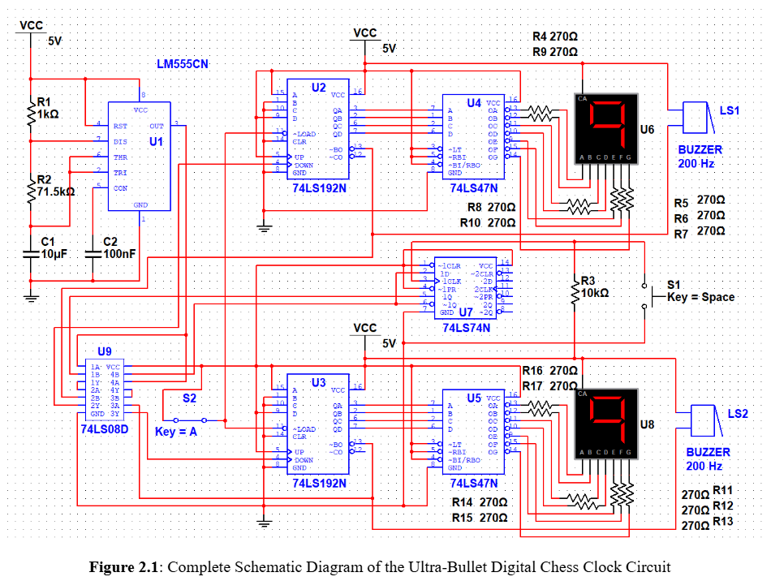
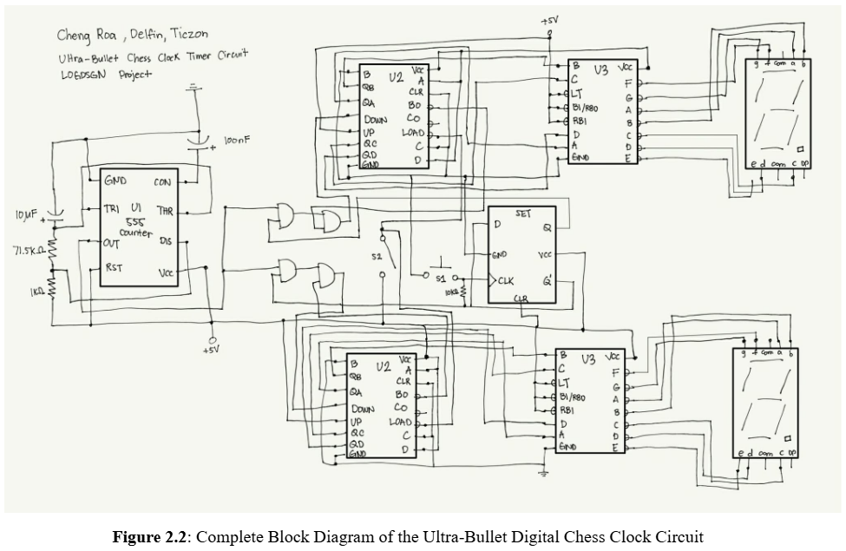
CIRCUIT SCHEMATIC & BLOCK DIAGRAM

Slide 5
HARDWARE OPTIMIZATION & ADDED FEATURES
  Noise Margin Optimization: Active-LOW switch with 10 kΩ pull-up guarantees VIN(HIGH) = 4.8 V ≥ 2.0 V with a high noise margin of NMH= 2.8 V and NML= 0.8 V.
  Fan-Out & Drive Safety: 74LS08 gate drives only 1 counter pin (ILOAD = 20 μA), utilizing only 5% of maximum TTL drive capacity (N = 20).
  Timing & Propagation Margins: Total path propagation delay (tpd≈40 ns) gives a 99.99996% timing margin relative to the 1 s clock period, eliminating race conditions.
  Display Current Limiting: Rseg = 270Ω safely restricts sink current to 9.63 mA per segment (PR = 25 mW << 250 mW rating).

Slide 6
DATA & RESULTS
  Functional simulations were tested in Falstad.
  Integrated validation was tested in Multisim
  Main section tested: clock, player-state register, clock routing, counter/display, and alarm
  Goal: verify that the chess clock works as a complete system

Slide 7
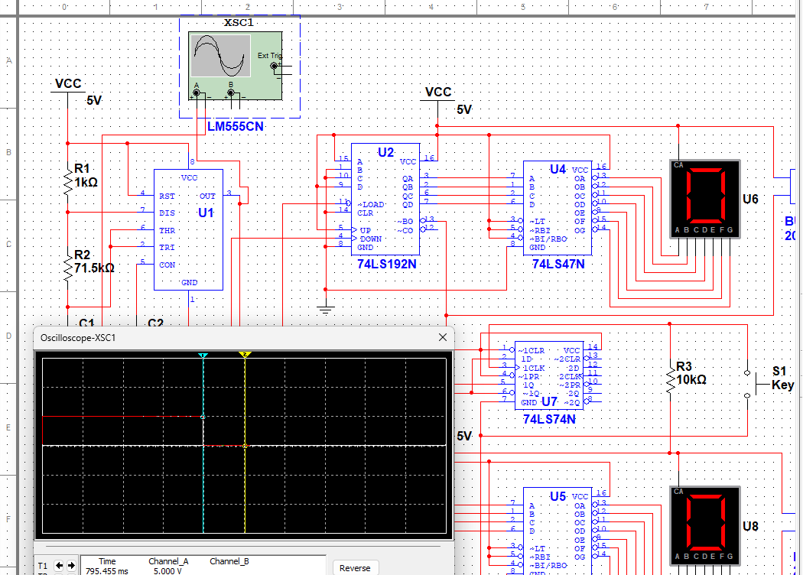
NE555/LM555 CLOCK GENERATOR
Figure 4.6A
  Produced a stable periodic clock signal
  Output voltage: around 0 V to 4.811 V/ 5 V
  Integrated frequency: 0.7652 Hz
  Timing deviation was noted, but the clock still worked as the system timing source

Slide 8
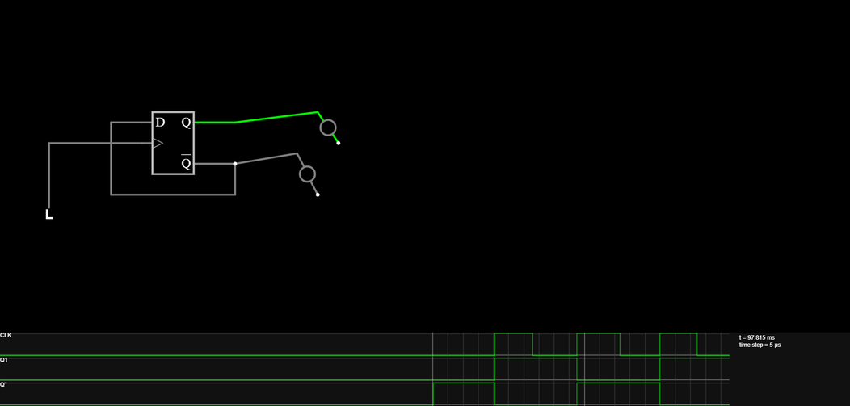
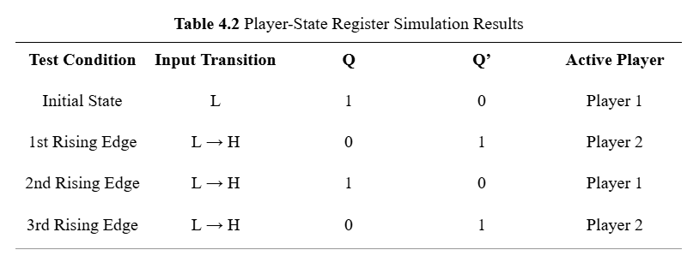
PLAYER-STATE REGISTER
Figure 4.2
74LS74 D flip-flop toggles active player
  Q = 1 means Player 1 active
  Q = 0 means Player 2 active
Each button/rising edge switches the active player

Slide 9

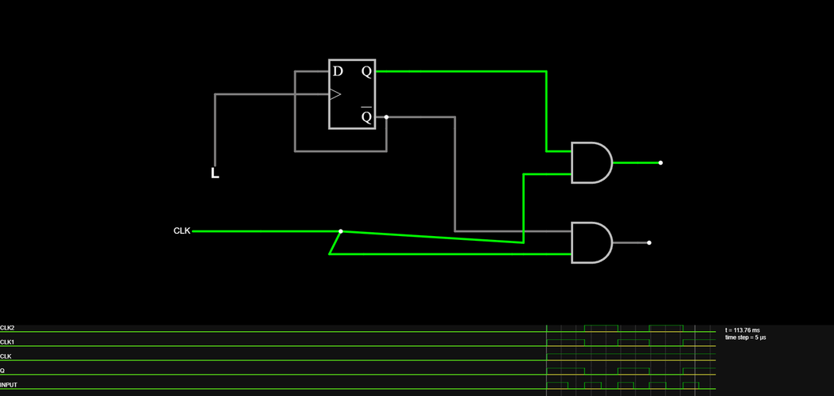
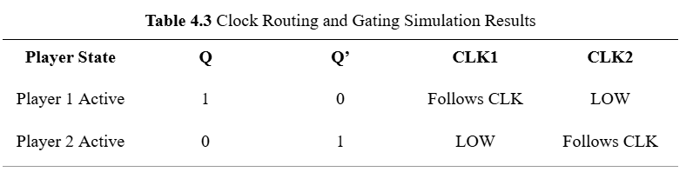
CLOCK ROUTING AND GATING
AND gates route the cllock to only one player
  Player 1 active: CLK1 follows clock, CLK2 LOW
  Player 2 active: CLK2 follows clock, CLK1 LOW
Prevents both timers from counting at the same time.

Slide 10
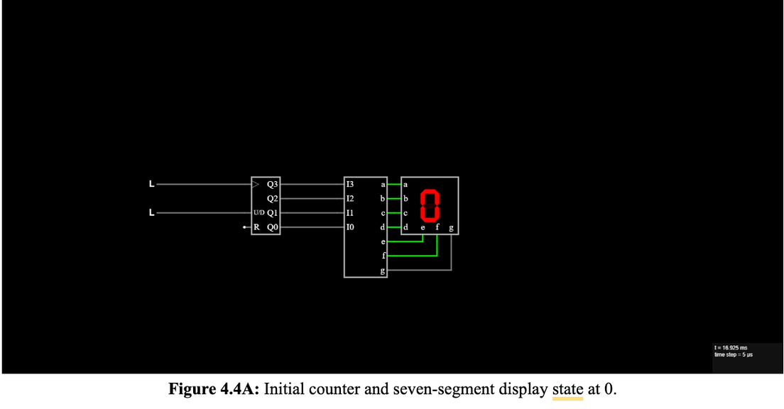
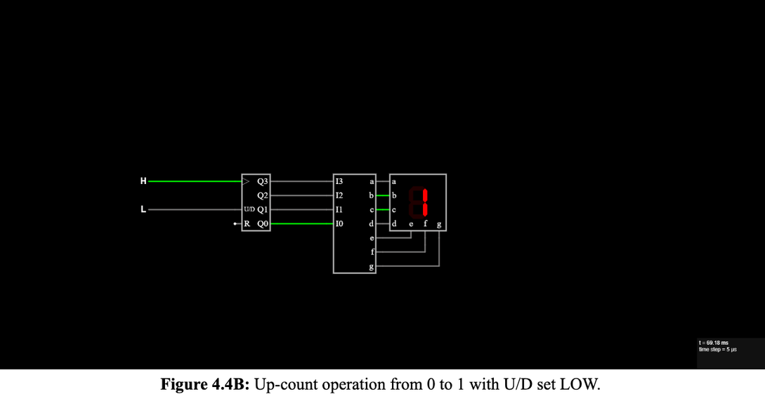
COUNTER AND SEVEN-SEGMENT DISPLAY
  Counter output was decoded to seven-segment display
  U/D LOW: count increases
  U/D HIGH: count decreases
  Falstad limitation: generic 4-bit counter wraps from 0000 to 1111, unlike actual 74LS192 BCD behavior

Slide 11
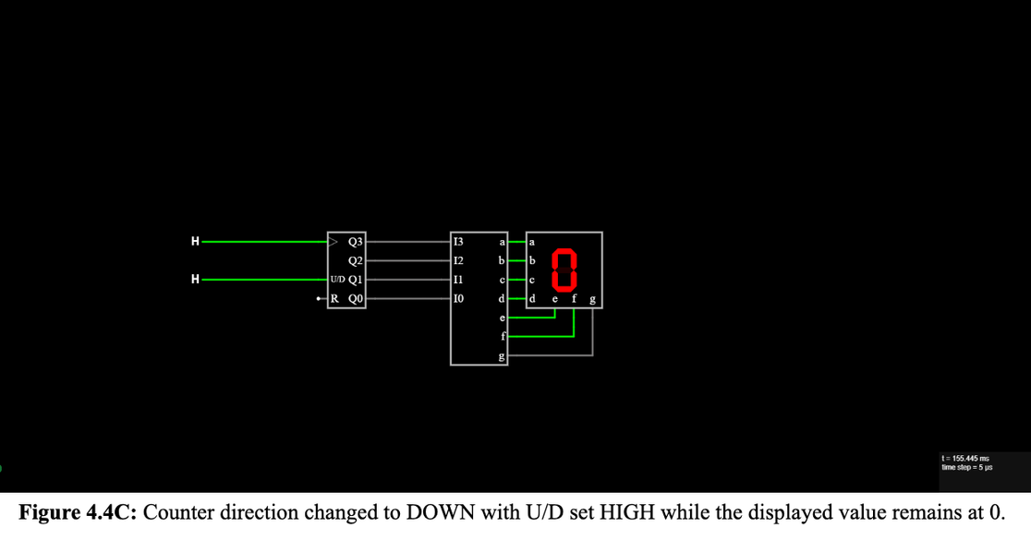
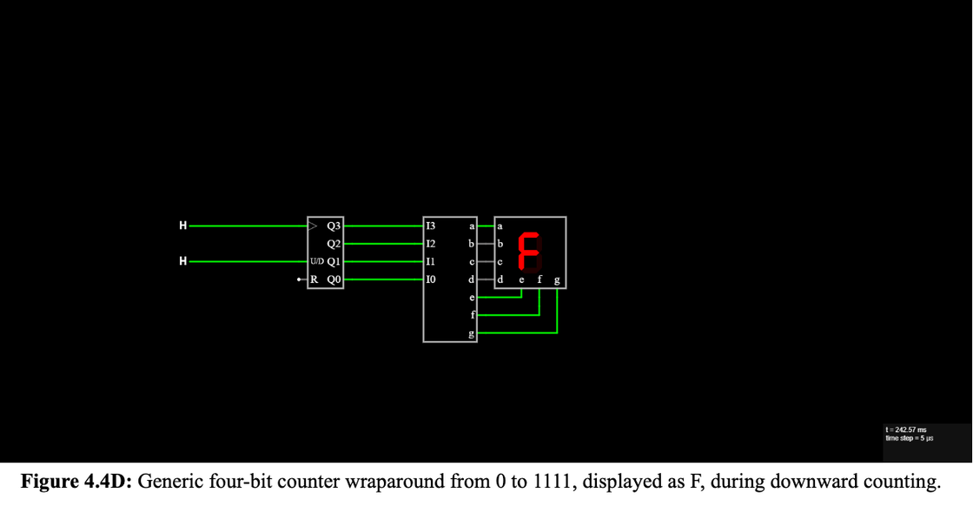
COUNTER AND SEVEN-SEGMENT DISPLAY

Slide 12
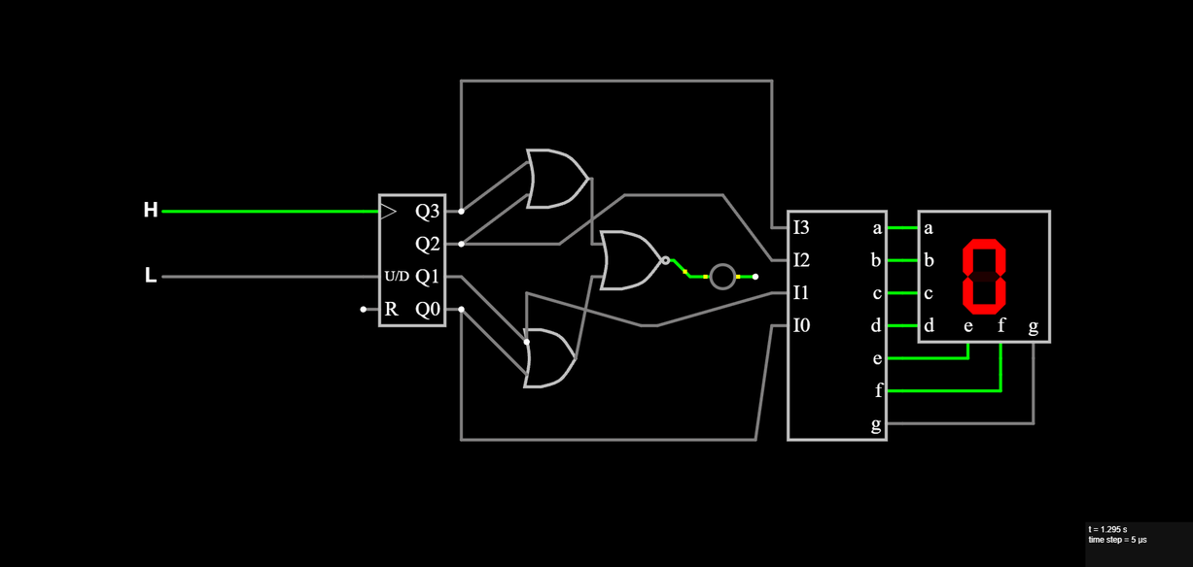
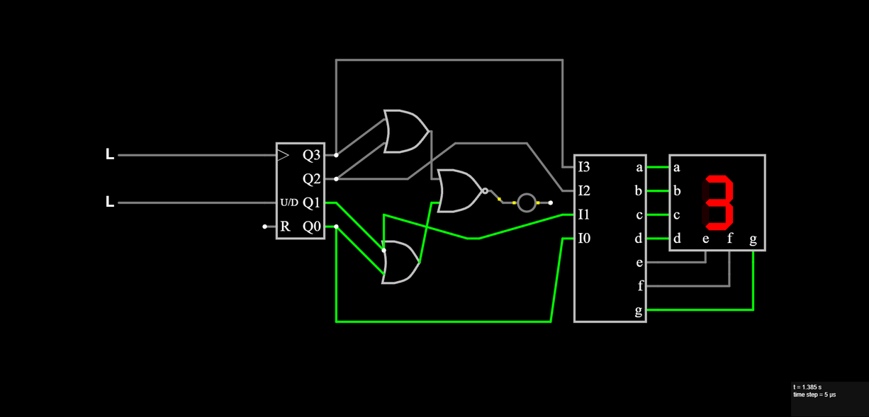
TERMINAL COUNT AND ALARM
Alarm activates only at counter output 0000
  At display 0: alarm HIGH/ON
  At display 3: alarm LOW/OFF
Confirms correct zero-detection behavior

Slide 13
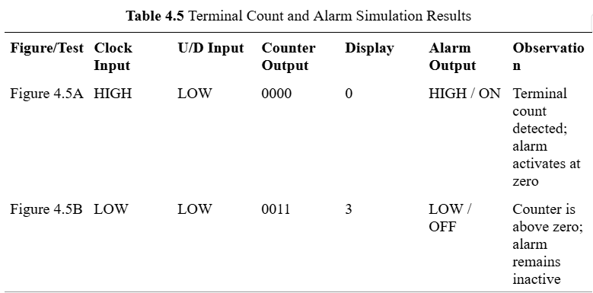
TERMINAL COUNT AND ALARM
Alarm activates only at counter output 0000
  At display 0: alarm HIGH/ON
  At display 3: alarm LOW/OFF
Confirms correct zero-detection behavior

Slide 14
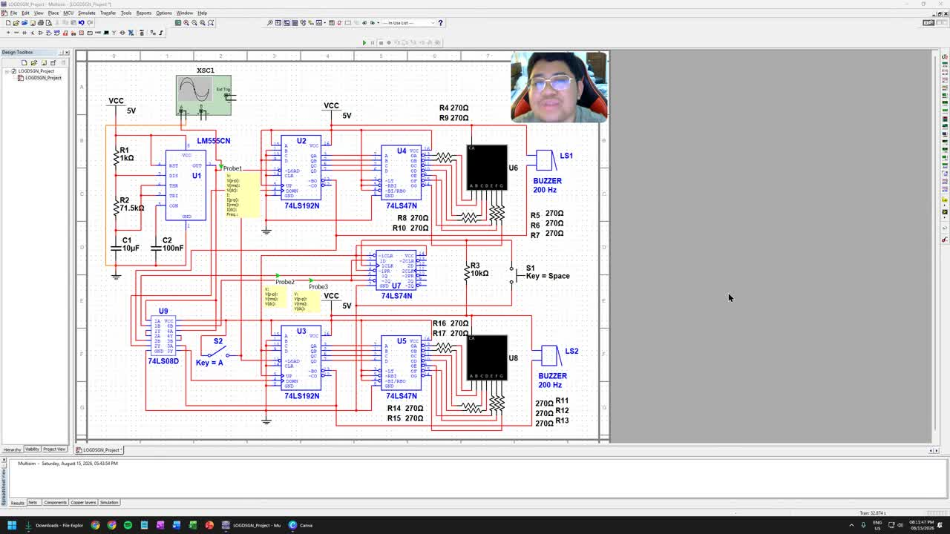
SIMULATION DETAILS

Slide 15
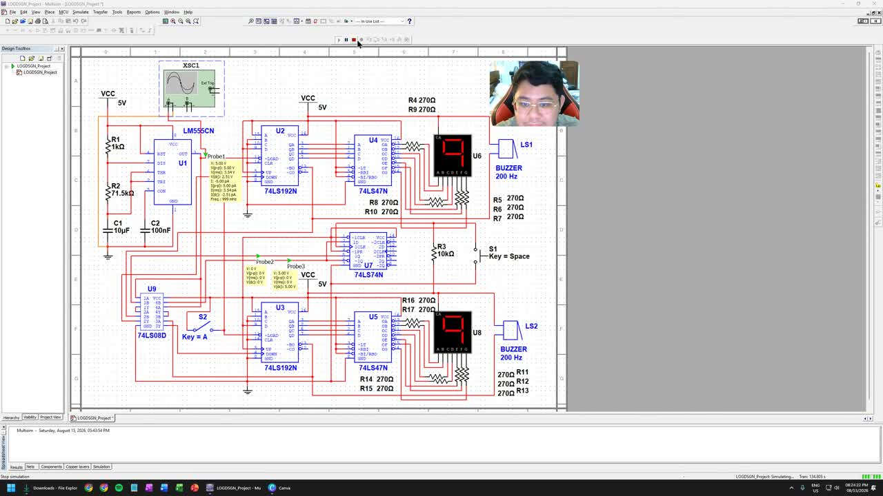
SIMULATION DONE

Slide 16
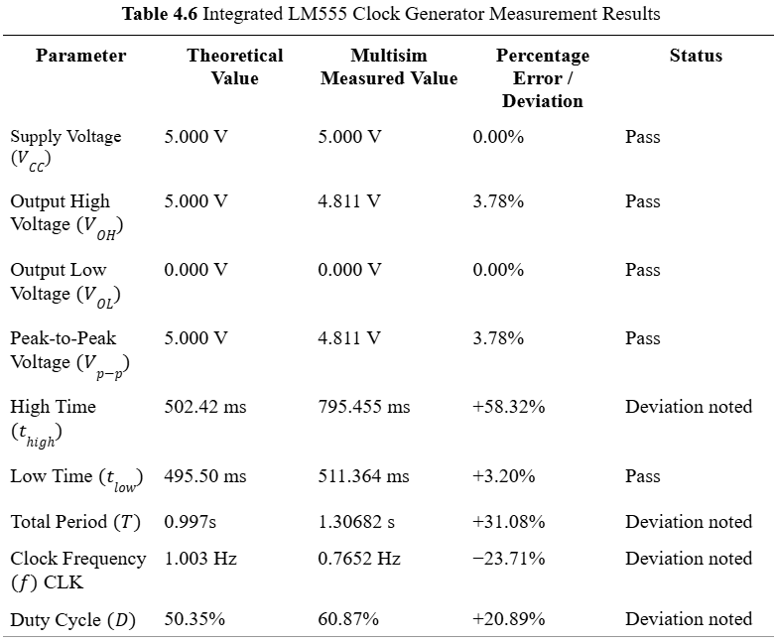
INTEGRATED MULTISIM VALIDATION
  Actual IC modes were used: LM555CN, 74LS74, 74LS08, 74LS192, 74LS47
  TTL voltage levels passed requirements
  Clock routing worked correctly
  Main logic functions operated as intended

Slide 17
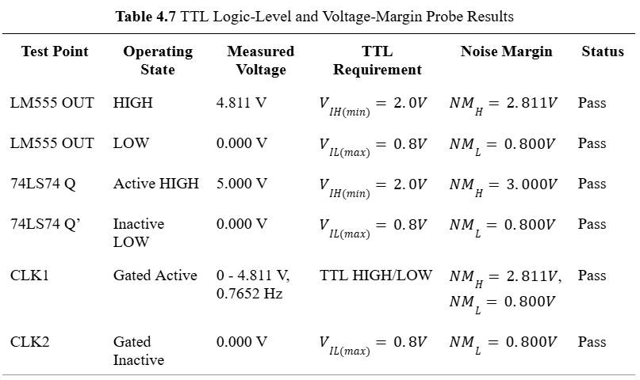
INTEGRATED MULTISIM VALIDATION

Slide 18
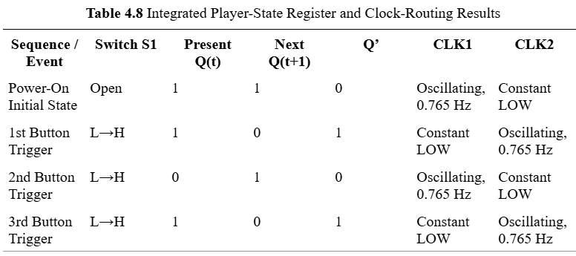
INTEGRATED MULTISIM VALIDATION

