Slide 1



COLLECTING WASTE FROM POLLUTED WATERS USING 'MEGA BOX' ROBOT
Grade 10 – Br. Flavius
PASION, Riona Dane DJ.
SALVADOR, Kymberlee Reinne
JARDIN, Thomas Edmund T.
DIMAANO, Andrea Mikael C.
CHENG ROA, John Carlo E.
RELAYO, Samantha Klein B.
MENDOZA, Justine Paul L.
TOPACIO, Deniel Ashly C.

Slide 2
INTRODUCTION
Plastic products have played significant roles in protecting people during the COVID-19 pandemic. The widespread use of personal protective gear (PPE), and the popularity of online shopping have created a massive disruption in the supply chain and waste disposal system.
Robotics, on the other hand helps to solve complex tasks using engineering and science to solve one of the biggest problems, pollution.

Slide 3
INTRODUCTION
This research is important because it attempts to aid in the resolution of the pollution problem by focusing on areas such as water, which are more difficult to clean up than land.
This study also allows easy management without the additional cost and heavy maintenance, thus providing a more efficient way of addressing water pollution.

Slide 4
INTRODUCTION
The research will concentrate on the Waste-Shark inspired mega box robot’s capacity to collect waste on the calmest bodies of water. If the robot is used when the waves or tides aren’t too big, the use of this robot will be much more effective.
The researchers should use a long-life battery span to maximize the capacity of robot usage and should also focus on how far does the controller’s range can go. The estimated weight of how much our robot can carry is around 15 – 18 liters so that it can function properly.

Slide 5
Research Objectives
This Investigatory Project's goal is to reduce waste in bodies of water.
Another objective is to build a low-cost robot that can be built as a DIY project in the comfort of anyone's home or workshop and yet perform well.

Slide 6
STATEMENT OF THE PROBLEM
What condition can the robot perform to its maximum potential in terms of (a) quality of water sources based on data collected from sensors or water monitoring system (b) waste collection
How much trash/pollution can the robot carry in one session while in water?
How long would the robot function under heavy payloads - requiring using maximum speed due to too many trash/pollutions inside the net?

Slide 7
Conceptual/ Research Framework
INPUT
- mega box
- fish net
- metal propeller
- servo
- shafts stainless steel
    - brushless motor
    - ESC
    - 4s/5s battery
    - receiver

Slide 8
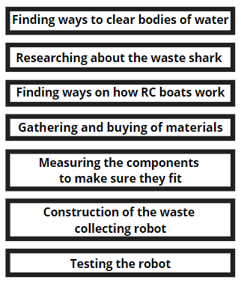
Conceptual/ Research Framework
PROCESS

Slide 9
Conceptual/ Research Framework
OUTPUT
COLLECTING SOLID WASTE FROM POLLUTED WATERS USING 'MEGA BOX' ROBOT

Slide 10
Methodology
The materials that the researchers need for this study are the mega box (66.5 cm x 45 cm) (1) , fish net (1) , metal propeller (1) , and servo (1). The study also needed Shafts stainless steel (1), brushless motor (1), ESC (1), and 4s/5s battery (1). Last is the receiver (1), the research needs a receiver for the robot to work.

Slide 11
Methodology
Finding ways to clear bodies of water.
Rivers for example are a vast expanse of water, polluted by human wastes and trash. The researchers need to find ways to clean it up, like we would care for our own lawn or backyard.
Researching about the waste shark
After determining the purpose of the task, researchers sought out existing study/technology related to the goal. The researchers saw the waste shark mega box (WSM) as the best idea to clean up ocean wastes.
Finding ways on how RC boats work
The WSM should be able to move through the ocean waters to collect plastic wastes floating in the ocean. The researchers turn to apply the technology of RC boats to make the WSM swim in the ocean and do the job it was intended to do. The robot should work with a battery voltage of 14.8.
Gathering and buying of materials
The WSM must stay afloat and swim through the ocean. So, the researchers need to find the best material for the body, the automation to make it swim and gather waste, the energy system that will make it work, and the RC to control the WSM.

Slide 12
Methodology
Measuring components to make sure they fit
The prototype WSM will be smaller for the purposes of this project but should be expandable to a larger prototype as may be required by the actual body of water it will be servicing. The mega box (66.5 cm x 45 cm) (1), fish net (1), metal propeller (1), and servo (1) are the items required for this research. Shafts stainless steel (1), brushless motor (1), ESC (1), and 4s/5s battery (1) were also required for the investigation. The last component is the receiver (1), which is required for the robot to function.
Construction of the waste collecting robot
All materials now available and the measurements done, the team goes to work assembling the robot. The size of the megabox should be 66.5cm x 45cm.
Testing the robot
As the project comes to fruition, researchers test the WSM parts work before doing the test runs on water. After checking the functionality of the WSM, researchers will put the project to test in a shallow pool or body of water. The purpose at this point is to see the waste gathering functions at work. As the project works in the shallow pool, the researchers now make the final test of bringing the WSM to an actual river. This final test will not only check its waste gathering capability, but also the RC functions to enable the team to direct the unit to where it should be going to collect wastes and return to deposit the waste collected before it goes through another round. The variables that needs to be tested are the speed (10 kph), weight capacity (50kg), and its maximum time of operation (2 hours).

Slide 13
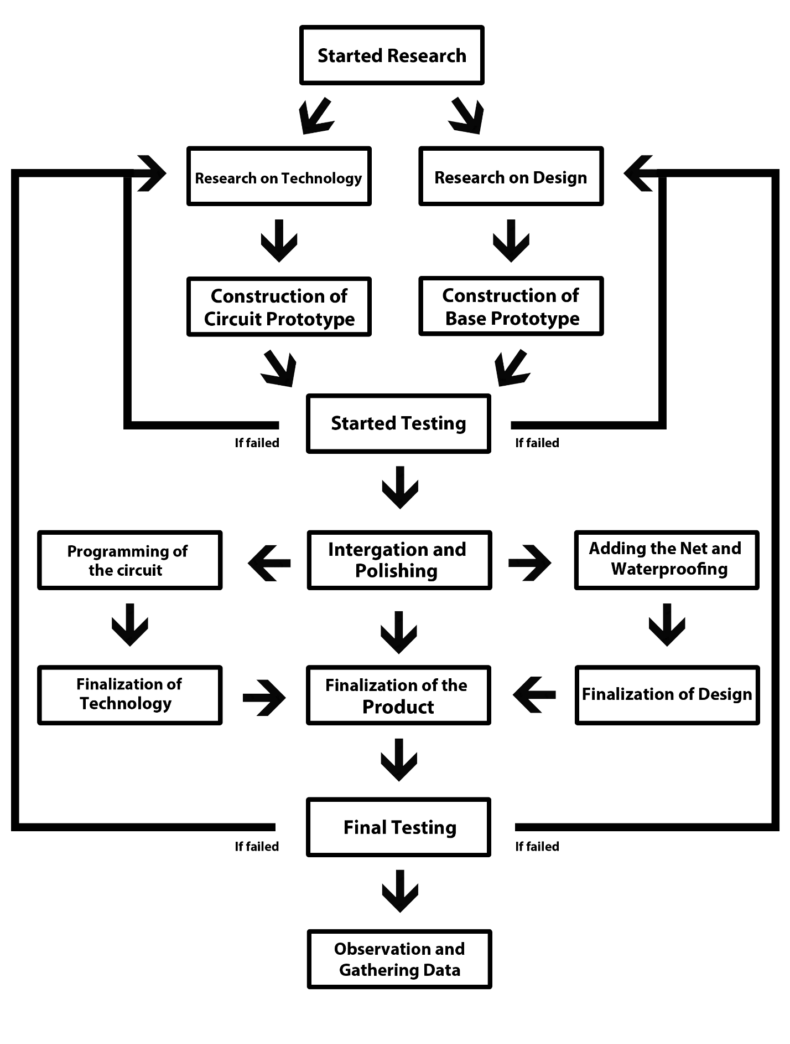
Schematic Diagram

Slide 14
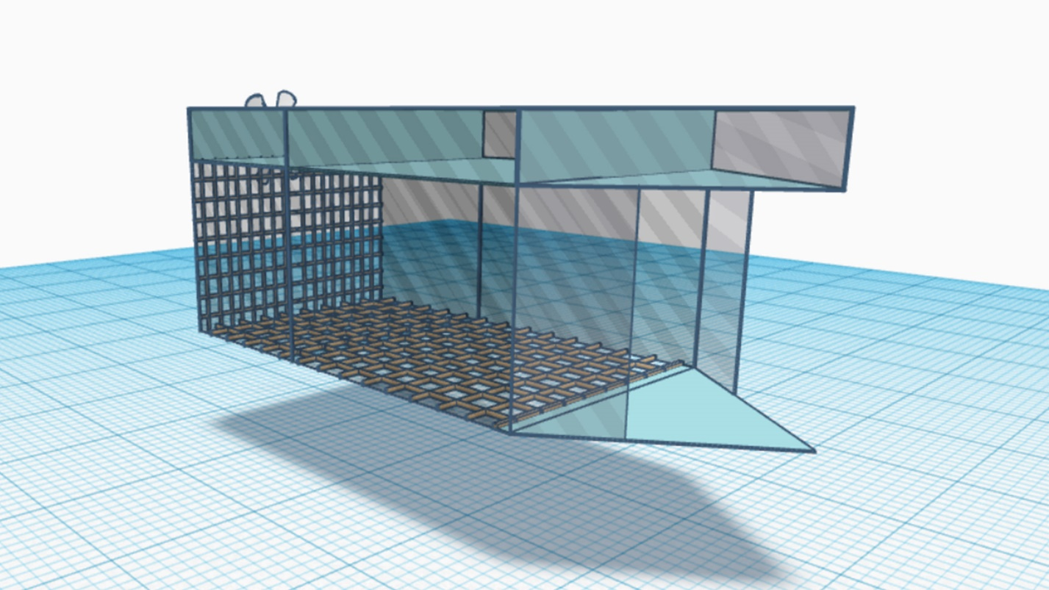
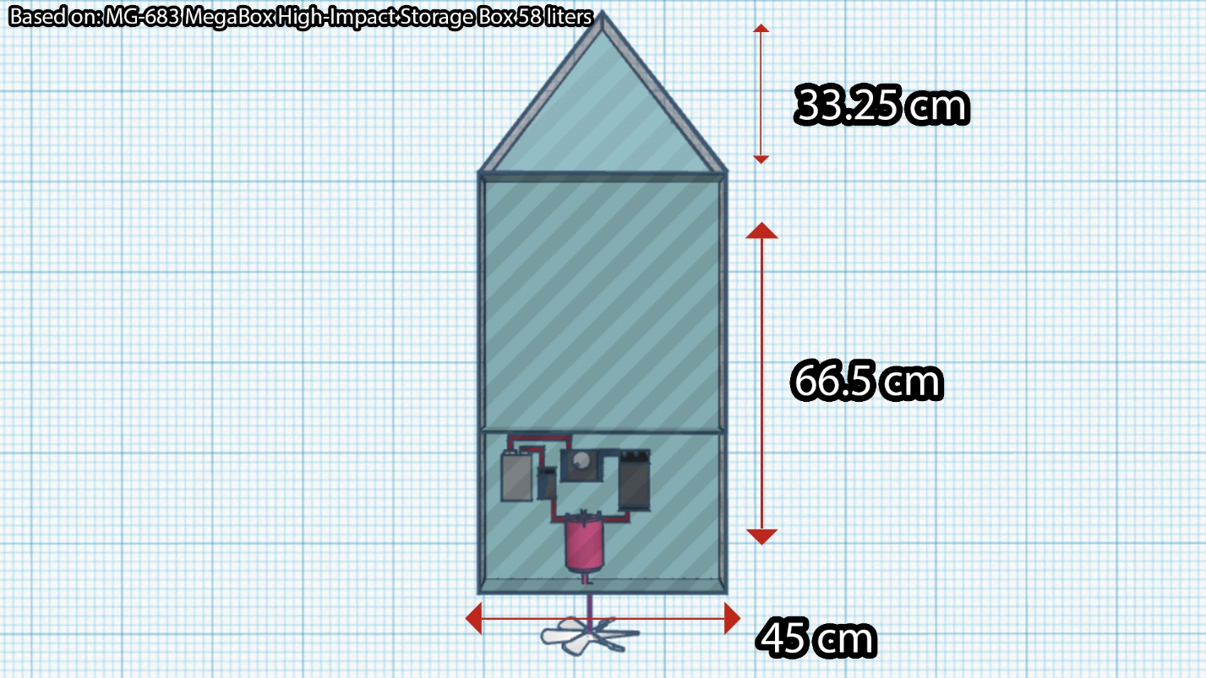
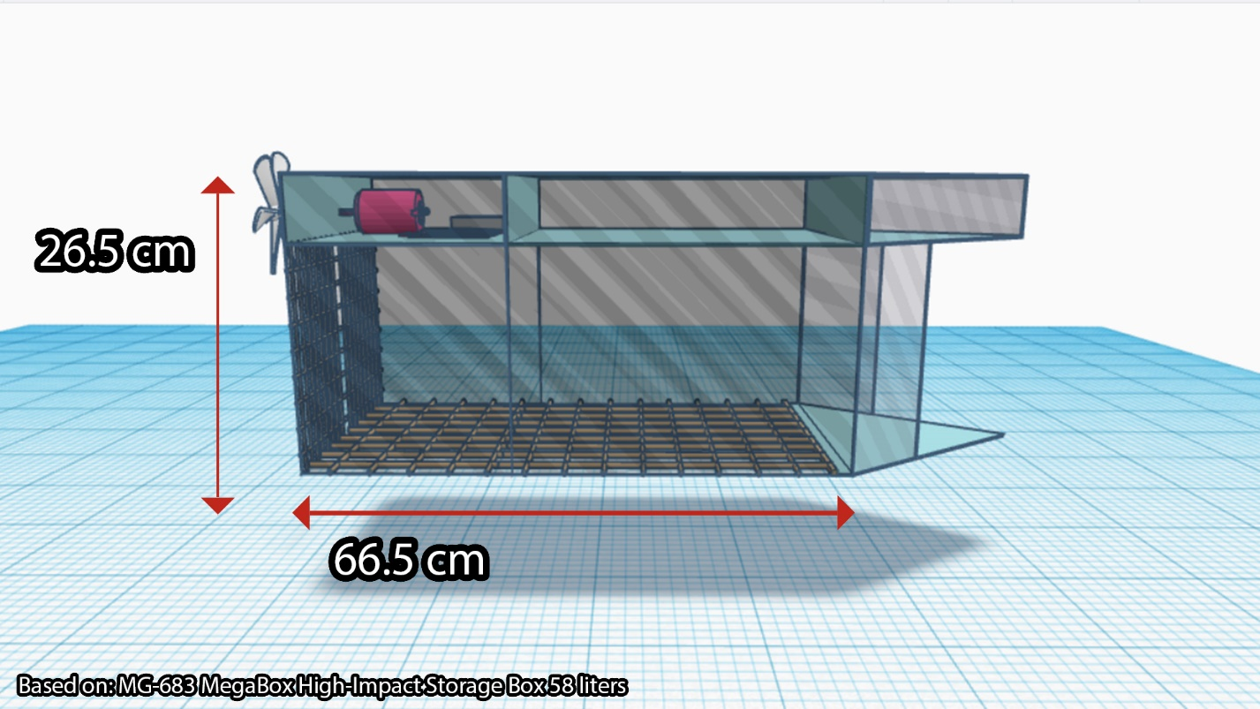
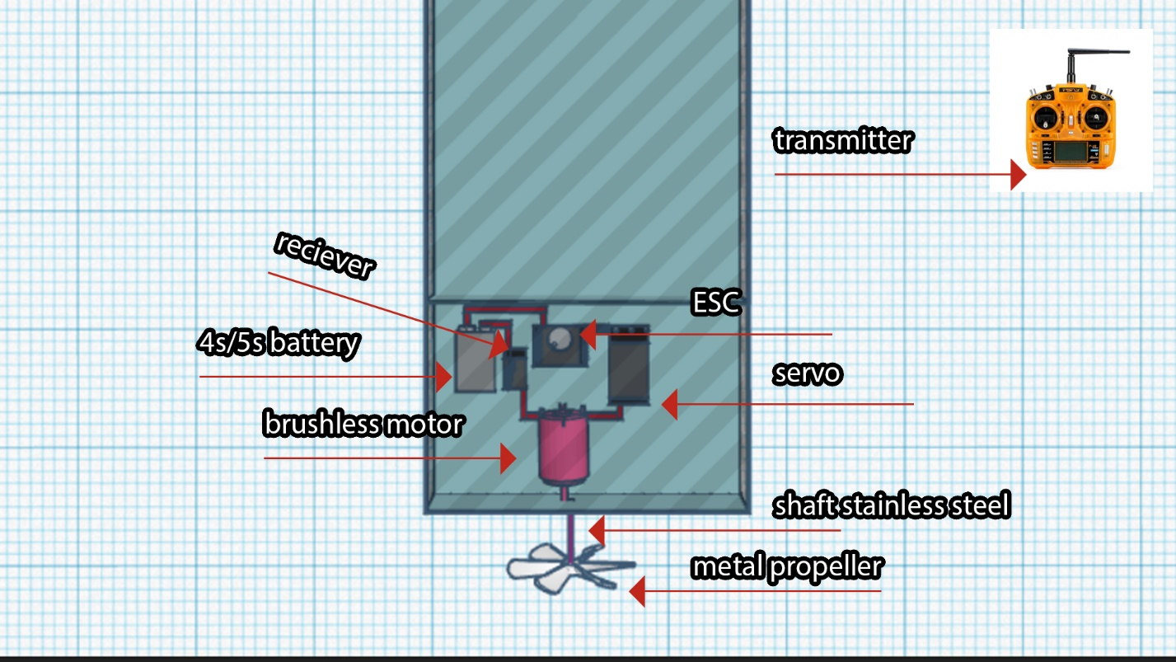
Research Output

Slide 15
Projected Cost Analysis
Item | Quantity/ Frequency | Amount | Subtotal (Quantity X Amount) | Location where it will purchased/ undertaken
Mega Box | 1 | PHP 199.00 | PHP 199.00 | Lazada
Fishnet | 1 | PHP 110.00 | PHP 110.00 | Lazada
Metal Propeller | 1 | PHP 1,117.00 | PHP 1,117.00 | Lazada
Servo | 1 | PHP 200.06 | PHP 200.06 | Lazada
Shaft Stainless Steel | 1 | PHP 110.00 | PHP 110.00 | Lazada
Brushless motor | 1 | PHP 573.00 | PHP 573.00 | Lazada
ESC | 1 | PHP 240.00 | PHP 240.00 | Lazada
4s/5s Battery | 1 | PHP 288.00 | PHP 288.00 | Lazada
Receiver/Transmitter | 1 | PHP 862.02 | PHP 862.02 | Lazada
TOTAL PHP 3,699.08 PHP 462.04 Per Student |  |  | / 8 Members

Slide 16
DATA PRESENTATION
This is how the presentation and analysis of the data will be gathered and organized from the trials of the mega box robot in which it will be tested for effectiveness in 5 trials. Here will be the data about the variables like the battery capacity, weight capacity, and the durability of the robot against nature and will be tested accordingly.
Table 1: Battery Capacity and Resistance
Trial | Time | Battery Resistance (ohms) | Battery Voltage (volts) | Battery Current (amps) | Power (kW)
1 | 2 hours
2 | 2 hours
3 | 2 hours
4 | 2 hours
5 | 2 hours

Slide 17
DATA PRESENTATION
Table 2: Weight Capacity and Speed
Requirements for a successful operation
of the Megabox Robot
Table 3: Durability against nature
Trial | Time | Speed (kph) | Capacity (kg) | Distance (km)
1 | 2 hours
2 | 2 hours
3 | 2 hours
4 | 2 hours
5 | 2 hours
Variables | Value
Temperature | 52.5 C
Weight Capacity | 50 kg
Speed | 10 kph
Battery Capacity | 10 kw
Wind Resistance | 650 MH
Time Operating | 2 hours
Trial | Time | Speed (kph) | Opposing Speed (MH) | Adjusted Speed (kph)
1 | 2 hours
2 | 2 hours
3 | 2 hours
4 | 2 hours
5 | 2 hours

Slide 18

Acknowledgement
This investigatory project became a reality with the great support and help with all many individuals around us. We would like to express my sincere gratitude to everyone.
Foremost, we express our utmost gratitude to the GOD, Almighty for the strength, understanding, and wisdom he blessed us and the peace of mind and good health in order to finish the project.
We would like to give thanks to our own families for the support and encouragement that they gave to us. To our beloved parents, for their unconditional love and unwavering support, to our siblings and to our relatives that give us happy times whenever there are troubles.
We are greatly indebted to our institution, De La Salle Araneta University, for the great education that it provides to its students. The constant supervision and guidance that it gives. To our principal, Dr. Irene U. Dalog, to our class adviser, Mr. Danilo Dogillo Jr., for being role models in our current endeavors.
Lastly, we would like to express our gratitude to our Science teacher, Ms. Criselda Espiritu, for always bringing the best out in all of us. For all the ups and downs, and for being one of the bests, we thank you, Ms. Crissy!

Slide 19
References
  Adyel, T., (2020, September 11). Accumulation of plastic waste during COVID-19. AMERICAN ASSOCIATION FOR THE ADVANCEMENT OF SCIENCE. Retrieved from https://science.sciencemag.org/content/369/6509/1314
  Environmental Pollution (n.d.) Retrieved from https://www.everythingconnects.org/pollution.html#
  Hunt, K., (2019, May 31). This Drone Sucks Up Trash from The Water Like a Roomba. Green Matters. Retrieved from https://www.greenmatters.com/community/2018/08/27/Z1TOS8s/wasteshark-aquadrone-ranmarine-technology
  Khan, M.A., (2020, June). Garbage collector robot. ResearchGate. Retrieved from https://www.researchgate.net/publication/342314471_Garbage_collector_robot
  Kumar, P., Masago, Y., Mishra, B. K., Fukushi, K. (2018, March). Groundwater for Sustainable Development. ScienceDirect. Retrieved from https://www.sciencedirect.com/science/article/abs/pii/S2352801X17301674#
  Robotics (n.d.) TechTarget. Retrieved from https://whatis.techtarget.com/definition/robotics#:~:text=Robotics%20is%20a%20branch%20of,%2C%20mechatronics%2C%20nanotechnology%20and%20bioengineering
  Santosh (2011, August). Playing with Waves. Business Today. Retrieved from https://www.businesstoday.in/magazine/how-things-work/rc-toys-radiowaves/story/17649.html
  Yan, X., Ziyang F., (2020, April 27). 10 technology trends to watch in the COVID-19 pandemic. World Economic Forum. Retrieved from https://www.weforum.org/agenda/2020/04/10-technology-trends-coronavirus-covid19-pandemic-robotics-telehealth/

